Slide 1
Trees
Dr. Maher Mneimneh

Slide 2
Tree Concepts
A way to organize data
Consider a family tree
When we categorize data into groups or subgroups we get a hierarchical representation
Hierarchical organization
Data items have ancestors, descendants
Contrast with previous linearly organized structures
Stack/Queues/Lists:
position-oriented
associates between data and positions
We would like to allow representing groups and subgroups
Natural representation for various real-world data
Improve the cost of searching

Slide 3
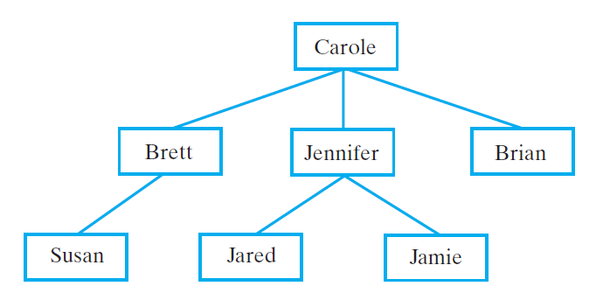
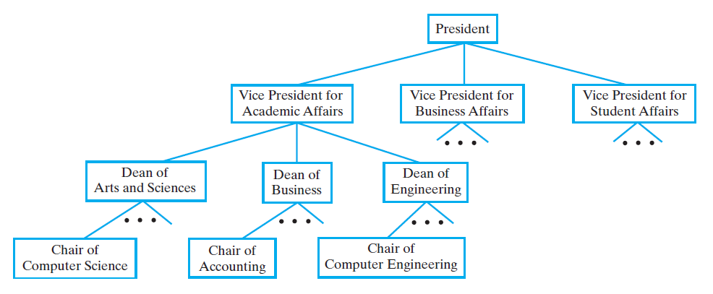
Tree Concepts
Family tree
Can be organized in multiple ways
Here we show the grandparent at top
A university’s administrative structure
staff is organized hierarchically
3 VPs are beneath the president

Slide 4
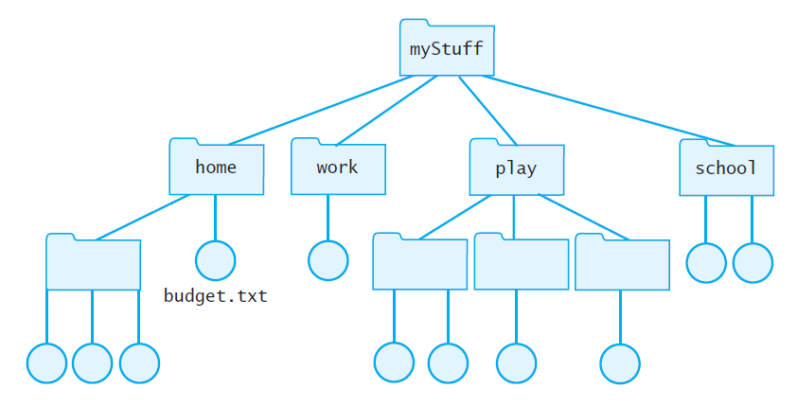
Tree Concepts
Computer files organized into folders
Organization of folders is hierarchical
Each folder contains another folder or file, or is empty
top folder is myStuff
to find budget.txt, start at myStuff, find folder home, and then locate budget.txt

Slide 5
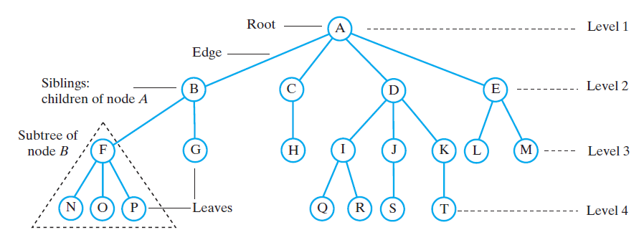
Tree Concepts
Tree is set of nodes storing data such that the nodes have following parent relationship:
One node has no parent – it is called the root
Every node different from root has exactly one parent p
Example figure below:
node A has no parent – call it root of tree
Every other node has exactly one parent (example : A is parent of B, C, D, E)
Thus figure below is a tree
A node that has p as parent is called a child of p
B is a child of A
Nodes with the same parent are called siblings
B and C are siblings
A leaf is a node with no children
A parent node is also called a nonleaf or interior node

Slide 6
Tree Concepts
Path: a sequence of nodes where
each 2 consecutive nodes satisfy parent relationship, and
no nodes are repeated
Examples: A,B,G is a path, K, D, A is a path, B, A, E is a path
A,H,G is NOT a path (consecutive nodes are not connected by edges)
A,C,H,C is NOT a path (the node C is not unique in the path)
Length of a path: is the number of nodes on the path - 1
Length of path A,B,G is 2
A node a is an ancestor node n if a is on the path from root to n
A is ancestor of C, D, E
I is NOT an ancestor of J
If a is ancestor of n, then n is descendent of a
H is a descendent of A
J is NOT a descendent of C

Slide 7
Tree Concepts
Nodes are arranged in levels that indicate the hierarchy
level(root) = 1
level(node n) = 1 + level(parent(n))
Sometimes the level is also called depth
We draw tree with root at top
Height of a tree is the numbers of levels in the tree
For tree below, the height is 4 because there are 4 levels

Slide 8
Tree Concepts
A node and its descendants form a subtree rooted at that node
Example: subtree rooted at F has nodes F, N, O, P
E.g: one subtree of node B is the subtree rooted at F
In a tree, a node can have any number of children
A has 4 children while C has one child
In an n-ary tree
Node has max n children
Binary tree node has max of 2 children

Slide 9
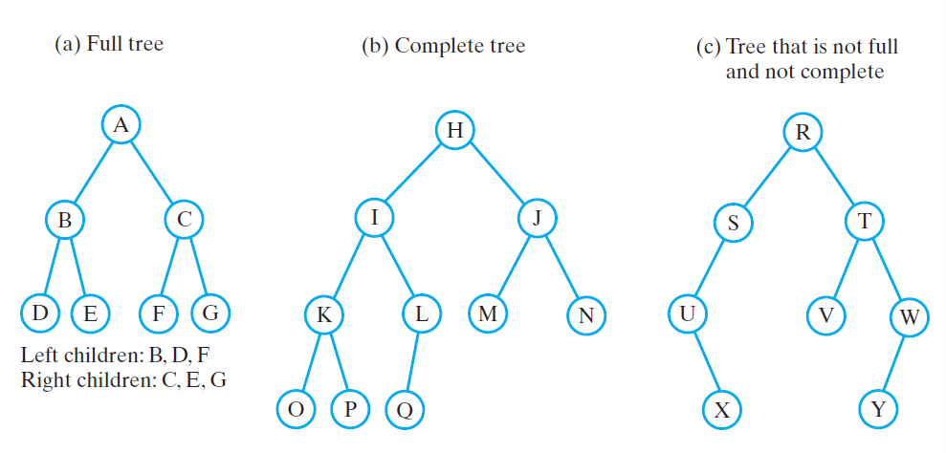
Binary Trees
Each node has at most 2 children: the left child and the right child
Example: B is left child of node A, node C is a right child
Root of binary tree has two subtrees: left subtree and right subtree
left subtree of A is rooted at B
right subtree of A is rooted at C
Each subtree of a binary tree is a binary tree (note the recursive definition)

Slide 10
Binary Trees
Full tree: A tree of height h is full if
Every non-leaf parent has 2 children
All leaves are at level h
Complete tree: A tree of height h is complete if
All levels except the last one contain as many nodes as possible
The last level is filled from left to right
Full binary trees are complete

Slide 11
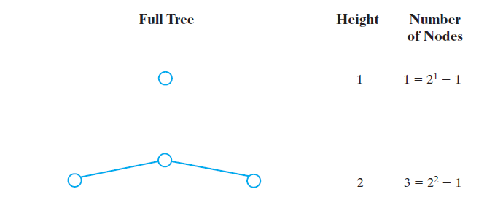
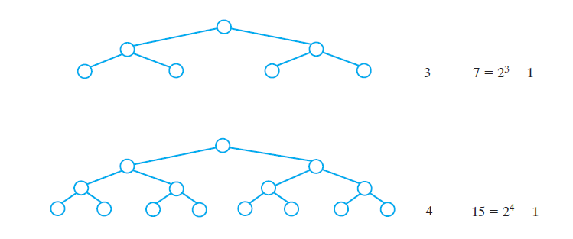
Binary Trees
Number of nodes of a full tree as a function of height
For full tree of height h, the sum of all nodes = 2^{h} -1

Slide 12
Binary Trees
Given a full tree with n nodes, what is the height of the tree?
We know that n = 2^{h} – 1
n+1 = 2^{h}
The height of a full binary tree with n nodes is log₂ (n + 1)
Similarly, for a complete binary tree, the height is log₂(n+1) rounded up
How do we compute log₂(a) in Java?
log_{a}x = log_{b}x/log_{b}a
Math.log(a) returns natural logarithm
log₂x = Math.log(x)/Math.log(2.0)
Examples:
How many nodes in a full tree of height 6?
What is the height of a complete tree that contains 14 nodes?

Slide 13
Examples: Expression Trees
Use binary tree to represent expressions
Two operands
One binary operator
The operator is the root
Can be used to evaluate an expression
Post order traversal
Each operand, then the operator
Captures details of evaluation without the need for parenthesis!

Slide 14
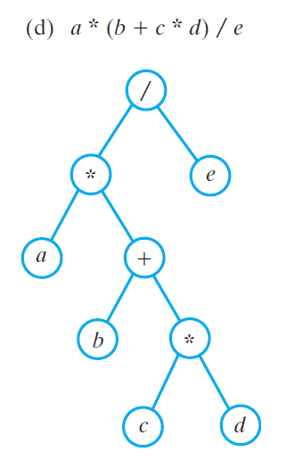
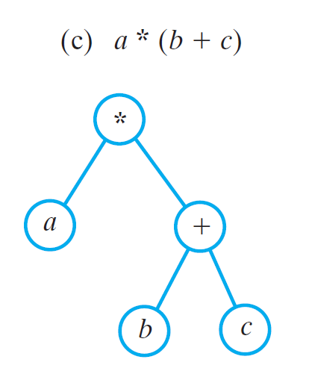
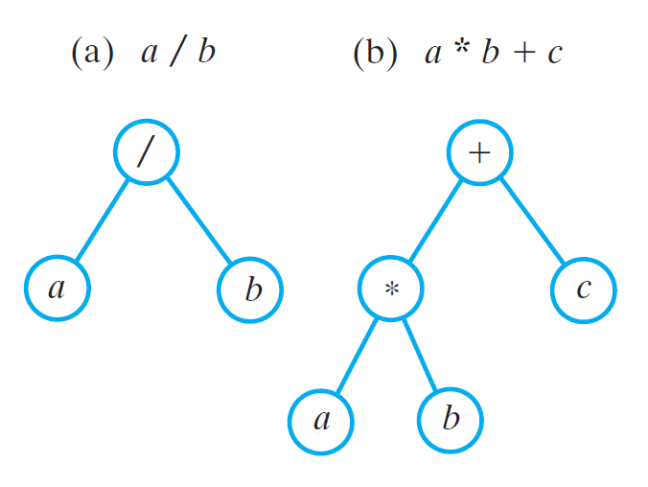
Examples: Expression Trees
Examples of expression trees below
Review:
infix/postfix/prefix expressions
Inorder traversal:
Visits variables and operands in the order they appear in infix expression
No parenthesis

Slide 15
Examples: Expression Trees
Preorder traversal:
Produces a prefix expression equivalent to original infix expression
example: preorder traversal of (b):
+ * a b c
no paranthesis
Postorder traversal:
Produces a postfix expression
Example: postorder traversal of (b):
a b * c +

Slide 16
Examples: Evaluating Algebraic Expressions
Operator is root of the tree
Operands are left and right tree
E.g: in figure (b) below:
if we know the value of a and b, we can evaluate a*b
if we know the value of a*b and c, we can evaluate a*b + c
Use postorder traversal to evaluate expression:
Visits root’s left subtree
Visits root’s right subtree
Visits root
We can use it to evaluate expressions

Slide 17
Binary Search Trees
Summary of dictionary
Can we do better with trees?
 | Sorted Array | Unsorted Array | Sorted Linkd List | Unsoted Linked List
Add | O(n) | O(n) | O(n) | O(n)
Remove | O(n) | O(n) | O(n) | O(n)
Search | O(logn) | O(n) | O(n) | O(n)

Slide 18
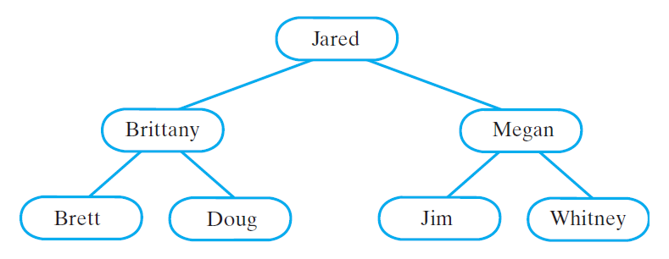
Binary Search Trees
Searching for data is a very important operation
How do we make performance better than sequential search?
Binary search tree solves this problem
Organizes data to make searching very efficient
Nodes contain Comparable objects
Organization: for each node in a search tree:
Node’s data greater than all data in node’s left subtree
Node’s data less than all data in node’s right subtree
Example: binary search tree of names
Jared as a string greater than all names in its left subtree
Jared as a string less than all names in its right subtree

Slide 19
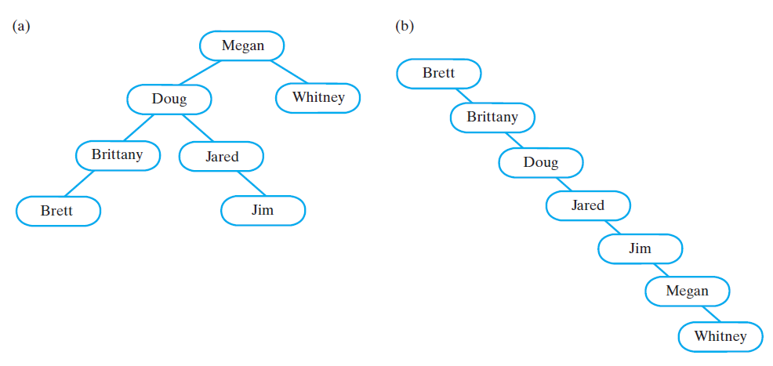
Binary Search Trees
We can form different binary search trees for the same data

Slide 20
Binary Search Trees
Organization of nodes enable us to search the tree for a particular object
Example: search for the string “Jim”
Begin at the root: Jim > Jared, so search the right subtree
Compare Jim and Megan: Jim < Megan, so search the left subtree
Compare Jim and Jim: object found
Example 2 : search for “Laura”
Compare Laura with Jared, then Megan and then Jim
Since Jim’s right subtree is empty, Laura doesn’t exist in data
Note the similarity to binary search: we are searching only half of the tree

Slide 21
Binary Search Trees: Efficiency
Example: search for the string “Jim”
Begin at the root: Jim > Jared, so search the right subtree
Compare Jim and Megan: Jim < Megan, so search the left subtree
Compare Jim and Jim: object found
Cost: 3 nodes examined
Example 2 : search for “Laura”
Compare Laura with Jared, then Megan and then Jim
Since Jim’s right subtree is empty, Laura doesn’t exist in data
Cost : 3 nodes examined

Slide 22
Binary Search Trees: Efficiency
Example: search for the string “Jim”
(a) : 4 comparisons
(b): 5 comparisons
The height of the tree affects the efficiency of wost-case search
For a tree of height h, worst case search is O(h)
What is the worst height for a tree of size n?
Searching in a binary tree with n nodes is O(n) in worst case
We will discuss strategies to keep the height of the tree short when adding and removing elements

Slide 23
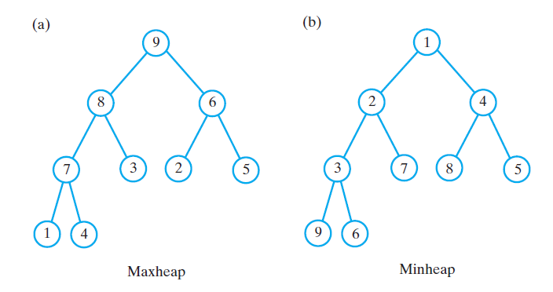
Heaps
Complete binary tree: nodes contain Comparable objects
Organization
Each node contains object no smaller (or no larger) than objects in descendants
Maxheap, object in node greater than or equal to descendant objects
Minheap, object in node less than or equal to descendant objects
Applications:
Heapsort: sort an array
Efficient priority queues

Slide 24
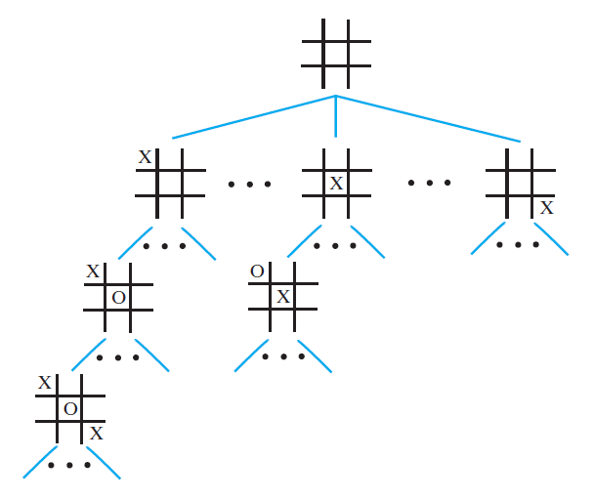
Examples of General Trees
Game trees
Tic-tac-toe:
Use a general decision tree to represent the states possible after the second player makes a move
If node represents move by Player 1
Children represent the states possible after Player 2 makes move

Slide 25
Traversals of a Tree
Traversal is common operation on data structures
Traversal of list (array based and reference based)
Most of the times either forward or backward
Must visit/process each data item exactly once but nodes can be visited/processed in different orders
Notes
‘Visit a node’ means process the data in the node
We can traverse a node WITHOUT ‘visiting it’ at this point
We will start with traversal on binary trees
For a binary tree
Visit the root
Visit all nodes in root’s left subtree
Visit all nodes in root’s right subtree
We will see that different traversals are possible, each suitable for a specific application

Slide 26
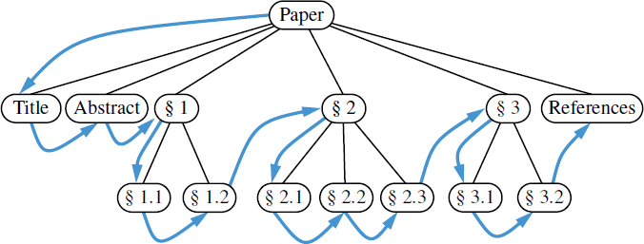
Traversals of a Tree
Example where preorder traversal is the right one to choose

Slide 27
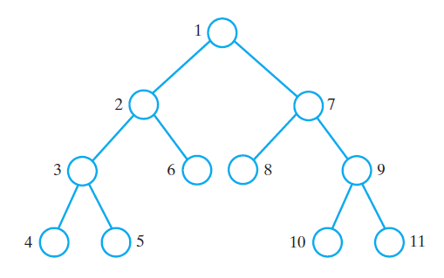

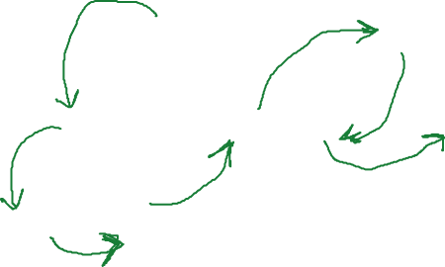

Traversals of a Tree
Preorder traversal:
Visit the root before visiting the root’s subtrees
Visit the nodes in the root’s left subtree
Visit the nodes in the root’s right subtree
Example below: nodes are numbered in order of traversal
a
a b d h i e c f g j k
b
c
d
e
f
g
h
i
j
k

Slide 28
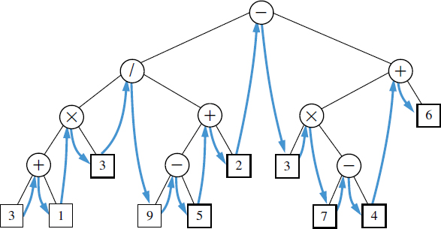
Traversals of a Tree
Example 1 where inorder traversal is the right one to choose
Example 2
return elements in sorted order in a binary search tree

Slide 29
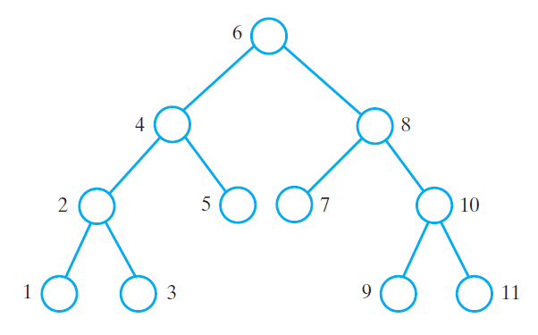



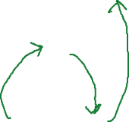

Traversals of a Tree
Inorder traversal:
Visit all the nodes in the root’s left subtree
Visit the root
Visit all the nodes in the root’s right subtree
Example below: nodes are numbered in order of traversal
a
h d i b e a f c j g k
b
c
d
e
f
g
h
i
j
k

Slide 30
Traversals of a Tree
Example where postorder traversal is the right one to choose
Display disk space usage in a filesystem

Slide 31
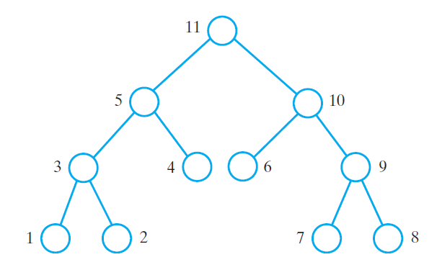








Traversals of a Tree
Postorder traversal:
Visit all the nodes in the root’s left subtree
Visit all the nodes in the root’s right subtree
Visit the root
Example below: nodes are numbered in order of traversal
a
h i d e b f j k g c a
b
c
d
e
f
g
h
i
j
k

Slide 32
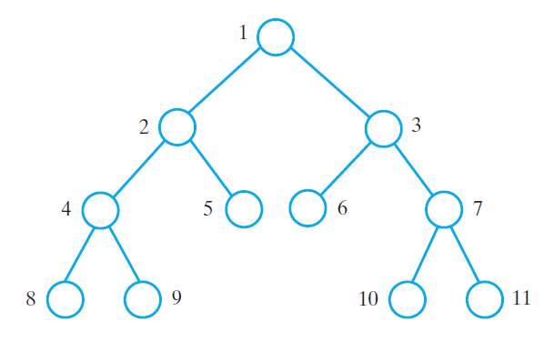
Traversals of a Tree
Level-order traversal:
Visit the nodes one level at a time
Within the same level, visit nodes from left to right
Example below: nodes are numbered in order of traversal
a
a b c d e f g h i j k
b
c
d
e
f
g
h
i
j
k

Slide 33
Traversals of a Tree
Level-order traversal
Example of breadth-first traversal
Pre-order traversal
Example of depth-first traversal
For a general tree (not a binary tree)
In-order traversal not well defined
Can do level-order, pre-order, post-order

Slide 34
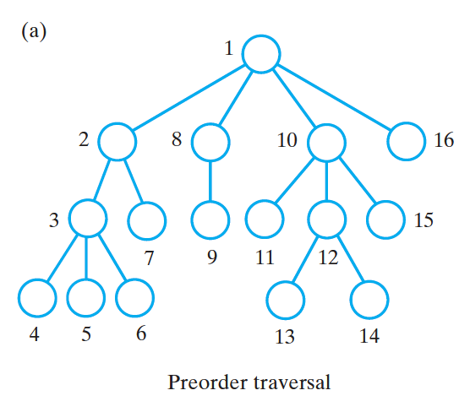
Traversals of a General Tree
Preorder traversal:
Visit the root before visiting the root’s subtrees
Visit the subtrees from left to right
Example below: nodes are numbered in order of traversal

Slide 35
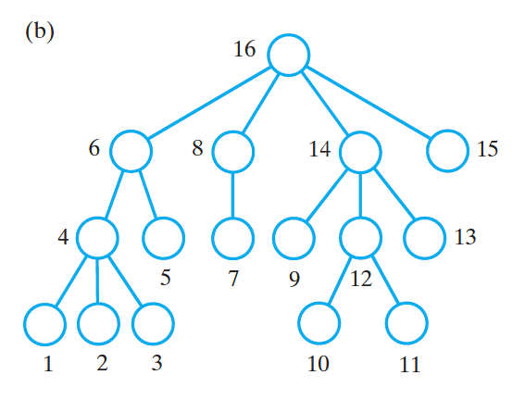
Traversals of a General Tree
Postorder traversal:
Visit the root after visiting the root’s subtrees
Visit the root’s subtrees from left to right
Example below: nodes are numbered in order of traversal

Slide 36
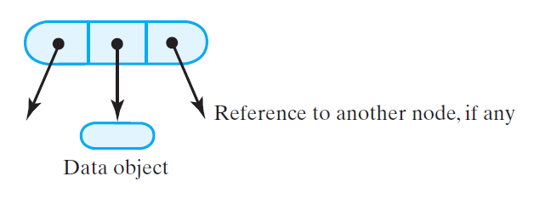
A Reference-Based Implementation of Binary Tree
We will implement a tree using linked structures
Array implementations are good for complete trees – discussed when we cover heaps
Elements in a tree are called nodes - similar to linked list
We will consider binary trees (general trees later)
Nodes in a binary tree
Reference to data object
Reference to left child and right child

Slide 37
An Implementation for a Binary Tree
public class BinaryTree<T>{
protected BinaryNode<T> root;
public BinaryTree() {
root = null;
} // end default constructor
public BinaryTree(T rootData) {
root = new BinaryNode<T>(rootData);
} // end constructor
public BinaryTree(T rootData, BinaryTree<T> leftTree,
BinaryTree<T> rightTree) {
privateSetTree(rootData, leftTree, rightTree);
} // end constructor
private void privateSetTree(T rootData, BinaryTree<T> leftTree,
BinaryTree<T> rightTree) {
root = new BinaryNode<T>(rootData);
if (leftTree != null)
root.setLeftChild(leftTree.root);
if (rightTree != null)
root.setRightChild(rightTree.root);
}
}

Slide 38
Implementation for a Binary Tree setTree
public void setTree(T rootData){
root = new BinaryNode<T>(rootData);
} // end setTree
public void setTree(T rootData, BinaryTree<T> leftTree, BinaryTree<T> rightTree) {
privateSetTree(rootData, leftTree, rightTree);
} // end setTree

Slide 39
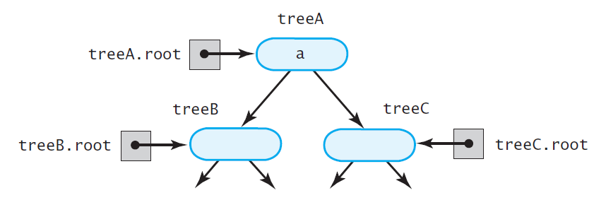
An Interface and Implementation for a Binary Tree
Creating a tree without copying children
Example:
BinaryTree<String> treeB = new BinaryTree<String>(“b”);
BinaryTree<String> treeC = new BinaryTree<String>(“c”);
BinaryTree<String> treeA = new BinaryTree<String>(“a”, treeB, treeC);
b
c

Slide 40
An Interface and Implementation for a Binary Tree
Creating a tree without copying children approach 2
Example:
BinaryTree<String> treeA = new BinaryTree<String>(“a”);
BinaryTree<String> treeB = new BinaryTree<String>(“b”);
BinaryTree<String> treeC = new BinaryTree<String>(“c”);
treeA.setTree(“a”, treeB, treeC);
b
c
What if treeB or treeC change?
treeA will change although this might be undesired
Programmers can spend significant time debugging the cause of changes in tree A

Slide 41
An Interface and Implementation for a Binary Tree
Creating a tree by copying left and right trees
treeA, treeB and treeC structure after copying
b
c
b
c

Slide 42
An Interface and Implementation for a Binary Tree
Solution 1
Copy a node before passing it to setTree
public BinaryNode< T > copy () {
BinaryNode < T > newRoot = new BinaryNode<>(data);
if (leftChild != null)
newRoot.leftChild = leftChild.copy ();
if (right != null)
newRoot.rightChild = right.copy ();
return newRoot;
}
private void privateSetTree (T rootData, BinaryTree < T > leftTree,
BinaryTree < T > rightTree) {
root = new BinaryNode < T > (rootData);
if ((leftTree != null) && !leftTree.isEmpty ())
root.setLeftChild (leftTree.root.copy ());
if ((rightTree != null) && !rightTree.isEmpty ())
root.setRightChild (rightTree.root.copy ());
}

Slide 43
Implementation for a Binary Tree
Solution 2
For treeA.setTree(“a”, treeB, treeC)
Link to the root nodes of treeB and treeC, and then set treeB.root and treeC.root to null
what if we have treeA.setTree(“a”, treeA, treeB)?
what if we have treeA.setTree(“a”, treeB, treeB)?
private void privateSetTree (T rootData, BinaryTree < T > leftTree,
BinaryTree < T > rightTree) {
root = new BinaryNode<>(rootData);
if ((leftTree != null) && !leftTree.isEmpty())
root.setLeftChild(leftTree.root);
if ((rightTree != null) && !rightTree.isEmpty()) {
if (rightTree != leftTree)
root.setRightChild(rightTree.root);
else
root.setRightChild(rightTree.root.copy());
}
if ((leftTree != null) && (leftTree != this))
leftTree.clear();
if ((rightTree != null) && (rightTree != this))
rightTree.clear();
}

Slide 44
An Interface and Implementation for a Binary Tree:
getRootData(), isEmpty(), clear(), getHeight(), getNumberOfNodes()
public T getRootData () {
T rootData = null;
if (root != null)
rootData = root.getData();
return rootData;
}
public boolean isEmpty () {
return root == null;
}
public void clear (){
root = null;
}
// getHeight and getNumberOfNodes call same functions in BinaryNode<T>
public int getHeight () {
return root.getHeight ();
}
public int getNumberOfNodes () {
return root.getNumberOfNodes ();
}

Slide 45
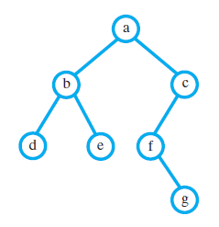
An Interface and Implementation for a Binary Tree:
Example: Building the binary tree whose contents are single-letter strings
What is the height and num of nodes of tree rooted at a?
What is the height and num of nodes of tree rooted at b?

Slide 46
An Interface and Implementation for a Binary Tree:
public static void createTree3(BinaryTree<String>{
// Leaves
BinaryTree<String> dTree = new BinaryTree<>(“d");
BinaryTree<String> eTree = new BinaryTree<>(“e");
BinaryTree<String> gTree = new BinaryTree<>(“g");
// Subtrees:
BinaryTree<String> fTree = new BinaryTree<>(“f", null, gTree);
BinaryTree<String> bTree = new BinaryTree<>(“b", dTree, eTree);
BinaryTree<String> cTree = new BinaryTree<>(“c", fTree, null);
BinaryTree<String> aTree = new BinaryTree<>(“a", bTree, cTree);
}

Slide 47
Traversing Recursively
Preorder traversal
Visit root, then left subtree, then right subtree
public void preorderTraverse() {
preorderTraverse(root);
}
private void preorderTraverse(BinaryNode<T> node) {
if(node != null) {
System.out.println(node.getData());
preorderTraverse(node.getLeftChild());
preorderTraverse(node.getRightChild());
}
}

Slide 48
Traversing Recursively
Inorder traversal
Visit all nodes in left subtree, then root, then right subtree
public void inorderTraverse() {
inorderTraverse(root);
}
private void inorderTraverse(BinaryNode<T> node) {
if(node != null) {
inorderTraverse(node.getLeftChild());
System.out.println(node.getData());
inorderTraverse(node.getRightChild());
}
}
What are the problems with above?
We should return the data and not print it so the client can process it if needed
Client might want to control when to visit the next node and not run entire traversal at once
can’t be done if we use recursion

Slide 49
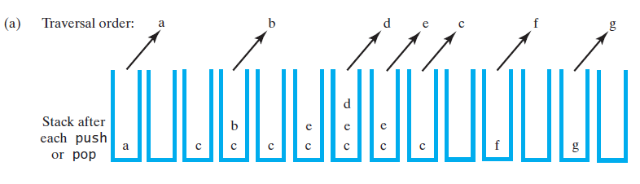
Non-recursive Preorder Traversal
public void preorderTraversal() {
Stack<BinaryNode<T>> nodeStack = new Stack<BinaryNode<T>>();
if (root != null)
nodeStack.push(root);
while(!nodeStack.isEmpty()) {
BinaryNode<T> nextNode = nodeStack.pop();
System.out.println(nextNode.getData());
BinaryNode<T> leftChild = nextNode.getLeftChild();
BinaryNode<T> rightChild = nextNode.getRightChild();
// push into stack in reverse order of recursive calls
if (rightChild != null)
nodeStack.push(rightChild);
if (leftChild != null)
nodeStack.push(leftChild);
}
}

Slide 50
Java Iterator - Review
package java.util;
public interface Iterator < T >
{
/** Detects whether this iterator has completed its traversal
and gone beyond the last entry in the collection of data.
@return true if the iterator has another entry to return */
public boolean hasNext ();
/** Retrieves the next entry in the collection and
advances this iterator by one position.
@return a reference to the next entry in the iteration,
if one exists
@throws NoSuchElementException if the iterator had reached the
end already, that is, if hasNext() is false */
public T next ();
/** Removes from the collection of data the last entry that
next() returned. A subsequent call to next() will behave
as it would have before the removal.
Precondition: next() has been called, and remove() has not been
called since then. The collection has not been altered
during the iteration except by calls to this method.
@throws IllegalStateException if next() has not been called, or
if remove() was called already after the last call to
next().
@throws UnsupportedOperationException if the iterator does
not permit a remove operation. */
public void remove (); // Optional method
}

Slide 51
Non-recursive Preorder Traversal
private class PreorderIterator implements Iterator<T> {
private Stack<BinaryNode<T>> nodeStack;
public PreorderIterator() {
nodeStack = new Stack<BinaryNode<T>>();
if (root != null)
nodeStack.push(root);
} // end default constructor
public boolean hasNext() {
return !nodeStack.isEmpty();
} // end hasNext

Slide 52
Non-recursive Preorder Traversal
public T next() {
BinaryNode<T> nextNode;
if (hasNext()) {
nextNode = nodeStack.pop();
BinaryNode<T> leftChild = nextNode.getLeftChild();
BinaryNode<T> rightChild = nextNode.getRightChild();
// push into stack in reverse order of recursive calls
if (rightChild != null)
nodeStack.push(rightChild);
if (leftChild != null)
nodeStack.push(leftChild);
}
else {
throw new NoSuchElementException();
}
return nextNode.getData();
} // end next
public void remove() {
throw new UnsupportedOperationException();
} // end remove
} // end PreorderIterator

Slide 53
Traversing Inorder and Non-recursively
Use stack to store information of 2 types :
tree node with blue circle
item node: value of node (no circle)
Push root tree (node with a blue circle)
while stack is not empty
If stack.top() is tree
pop tree node
push right tree, push item, push left tree
else (stack.top() is an item)
pop item
visit item
d
b
e
a
f
g
c
d
d
b
b
b
b
e
e
e
e
e
f
a
a
a
a
a
a
a
f
g
g
g
a
c
c
c
c
c
c
c
c
c
c
c
c
c

Slide 54
Traversing Inorder and Non-recursively
Push root tree (node with a blue circle)
currentNode = stack.top()
while stack is not empty
If stack.top() is tree
pop tree node (remove currentNode)
push right tree, push item, push left tree
else (stack.top() is an item)
pop item
visit item
push item’s right tree
d
b
e
a
f
g
c
d
d
b
b
b
b
e
e
e
e
e
f
a
a
a
a
a
a
a
f
g
g
g
a
c
c
c
c
c
c
c
c
c
c
c
c
c

Slide 55
Traversing Inorder and Non-recursively
public void inorderTraversal() {
Stack<BinaryNode<T>> nodeStack = new Stack<BinaryNode<T>>();
nodeStack.push(root);
BinaryNode<T> currentNode = nodeStack.top();
while(!nodeStack.empty()) {
currentNode = nodeStack.top();
if(currentNode.isTree() {
nodeStack.pop();
nodeStack.push(currentNode.right);
nodeStack.push(currentNode);
nodeStack.push(currentNode.left);
}
else {
BinaryNode<T> visitNode = nodeStack.pop();
System.out.println(visitNode.getData());
}
}
}
d
b
e
a
f
g
c
d
d
b
b
b
b
e
e
e
e
e
f
a
a
a
a
a
a
a
f
g
g
g
a
c
c
c
c
c
c
c
c
c
c
c
c
c

Slide 56
Traversing Inorder and Non-recursively
public void inorderTraversal() {
Stack<BinaryNode<T>> nodeStack = new Stack<BinaryNode<T>>();
BinaryNode<T> currentNode = root;
while(curretNode != null || !nodeStack.empty()) {
if(currentNode != null) {
nodeStack.push(currentNode);
curretNode = currentNode.getLeftChild();
}
else {
BinaryNode<T> visitNode = nodeStack.pop();
System.out.println(visitNode.getData());
currentNode = visitNode.getRightChild();
}
}
}
d
b
e
a
f
g
c
d
d
b
b
b
b
e
e
e
e
e
f
a
a
a
a
a
a
a
f
g
g
g
a
c
c
c
c
c
c
c
c
c
c
c
c
c

Slide 57
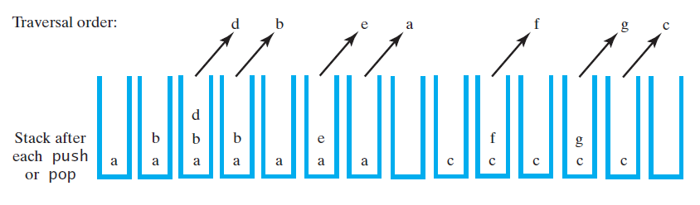
Traversing Inorder and Non-recursively
Book version – harder to understand, but same result
public void inorderTraversal() {
Stack<BinaryNodeInterface<T>> nodeStack = new Stack<BinaryNodeInterface<T>>();
BinaryNodeInterface<T> currentNode = root;
while (!nodeStack.empty() || currentNode != null) {
while(currentNode != null) {
nodeStack.push(currentNode);
currentNode = currentNode.getLeftChild();
}
if(!nodeStack.empty()) {
BinaryNodeInterface<T> nextNode = nodeStack.pop();
System.out.println(nextNode.getData());
currentNode = nextNode.getRightChild();
}
}
}

Slide 58
Traversing Using an Iterator
Implementation of non-recursive traversal
public void inorderTraversal() {
Stack<BinaryNode<T>> nodeStack = new Stack<BinaryNode<T>>();
BinaryNode<T> currentNode = root;
while (!nodeStack.empty() || currentNode != null) {
while(currentNode != null) {
nodeStack.push(currentNode);
currentNode = currentNode.getLeftChild();
}
if(!nodeStack.empty()) {
BinaryNode<T> nextNode = nodeStack.pop();
System.out.println(nextNode.getData());
currentNode = nextNode.getRightChild();
}
}
}
Check if there is a next node
Compute next node

Slide 59
Traversing Using an Iterator
Implementation of non-recursive traversal using Iterators
public Iterator<T> getInorderIterator() {
return new InorderIterator();
}
private class InorderIterator implements Iterator < T > {
private Stack< BinaryNode< T >> nodeStack;
private BinaryNode< T > currentNode;
public InorderIterator () {
nodeStack = new Stack < BinaryNode< T >> ();
currentNode = root;
} // end default constructor
public boolean hasNext () {
return !nodeStack.isEmpty () || (currentNode != null);
} // end hasNext

Slide 60
Traversing Using an Iterator
public T next () {
BinaryNode< T > nextNode = null;
// find leftmost node with no left child
while (currentNode != null) {
nodeStack.push(currentNode);
currentNode = currentNode.getLeftChild ();
} // end while
// get leftmost node, then move to its right subtree
if (!nodeStack.isEmpty ()) {
nextNode = nodeStack.pop ();
currentNode = nextNode.getRightChild ();
}
else
throw new NoSuchElementException ();
return nextNode.getData ();
} // end next
public void remove () {
throw new UnsupportedOperationException ();
} // end remove
} // end InorderIterator

Slide 61
Using the Inorder Iterator
public static void iteratorTraversal() {
// Build the tree
// Leaves: d, e, g
BinaryTree<String> dTree = new BinaryTree<String>("d");
BinaryTree<String> eTree = new BinaryTree<String>("e");
BinaryTree<String> gTree = new BinaryTree<String>("g");
BinaryTree<String> bTree = new BinaryTree<String>("b", dTree, eTree);
BinaryTree<String> fTree = new BinaryTree<String>("f", null, gTree);
BinaryTree<String> cTree = new BinaryTree<String>("c", fTree, null);
BinaryTree<String> aTree = new BinaryTree<String>("a", bTree, cTree);
System.out.println("Inorder traversal of tree rooted at A");
Iterator<String> iter = aTree.getInorderIterator();
while(iter.hasNext()) {
String s = iter.next();
// Process s if needed
System.out.println("String: " + s);
}
}
Output
Inorder traversal of tree rooted at A
String: d
String: b
String: e
String: a
String: f
String: g
String: c

Slide 62
Non-recursive Preorder Traversal
System.out.println("Preorder traversal of tree rooted at A using Iterator");
Iterator<String> iter2 = aTree.getPreorderIterator();
while(iter2.hasNext()) {
String s = iter2.next();
// Process s if needed
System.out.println("String: " + s);
}
Output:
Preorder traversal of tree rooted at A using Iterator
String: a
String: b
String: d
String: e
String: c
String: f
String: g

Slide 63
Non-recursive Postorder Traversal
Use stack to store information of 2 types :
tree node with blue circle
item node: value of node (no ciricle)
Push root tree (node with a blue circle)
while stack is not empty
If node is tree
pop tree node
push item, push right tree, push left tree
else (node is an item)
visit item
d
e
b
g
f
c
a
d
d
e
e
e
e
g
g
b
b
b
b
b
b
f
f
f
f
c
c
c
c
c
c
c
c
c
c
c
c
a
a
a
a
a
a
a
a
a
a
a
a
a
a

Slide 64
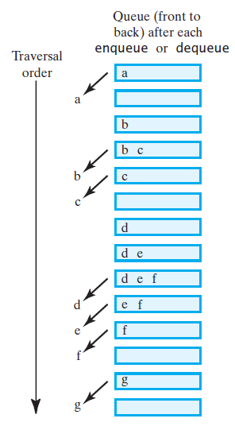
Non-recursive Levelorder Traversal

Slide 65
Application: Implementation of an Expression Tree
Use a tree to represent an algebraic expression
Extend the BinaryTree class and add a method evaluate()
Assume that the expression tree contains a string as its data
Assume 5 variables can occur in expression and their values are as follows:
a=1, b=2, c=3, d= 4, e=5
Look at ExpressionTree.java and Driver Example

Slide 66
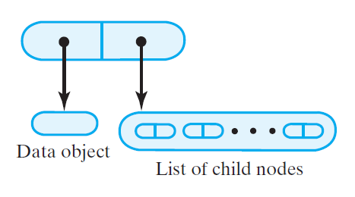
Node for a General Tree
Representing a general tree by adding reference to each node is difficult to handle
Solution 1:
Use 2 references:
one for the data
one is a list of children (can be a linked list or array)
Design an iterator for the children
Solution 2
How to use a binary tree to represent ANY tree?

Slide 67
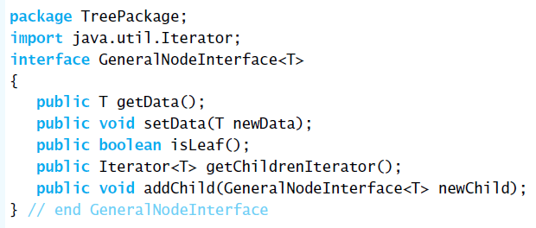
Node for a General Tree

Slide 68
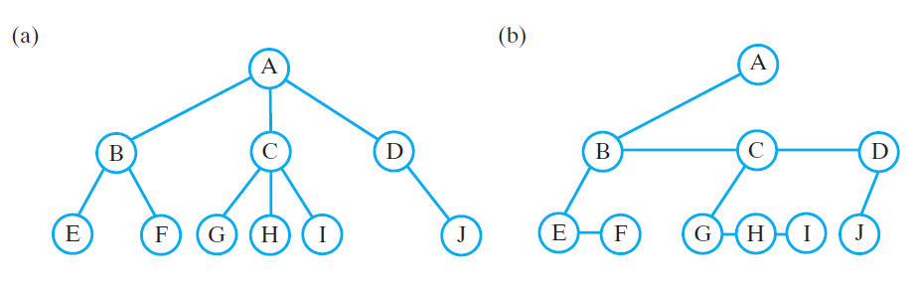
Using a Binary Tree to Represent a General Tree
Representing a general tree by adding reference to each node is difficult to handle
Converting a general tree to an equivalent binary tree
Give root one of its children (B) as a left child
Draw edge from B to sibling C and from C to D
In general each parent gets one of the children as a left child and its immediate sibling as a right child

Slide 69
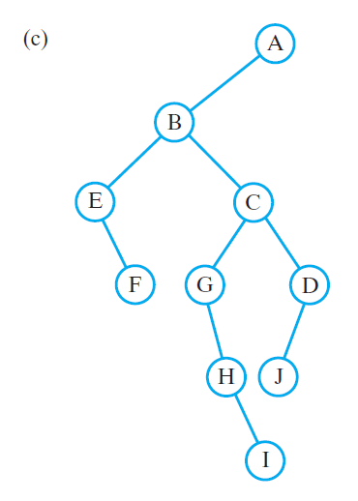
Using a Binary Tree to Represent a General Tree
Traversal of original tree:
Preorder: A B E F C G H I D J
Postorder: E F B G H I C J D A
Level order: A B C D E F G H I J
Traversal of binary tree:
Preorder: A B E F C G H I D J (same as above)
Postorder: F E I H G J D C B A (different)
Inorder: E F B G H I C J D A (same as postorder of original)
Level order: A B E C F G D H J I (different from level order of original)

